Slide 1
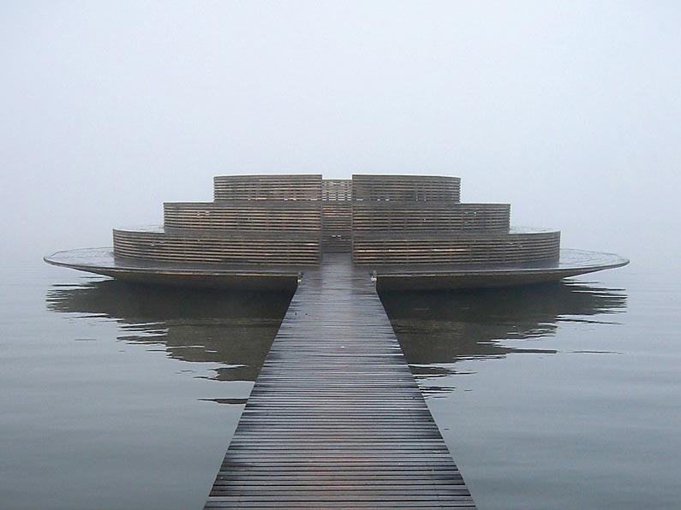

Hammarby Sjöstad/
- unique environmental project in Stockholm
Erik Freudenthal
Head of
Communications
in
GlashusEtt
The Environmental Information
Centre for Hammarby Sjöstad

Slide 2
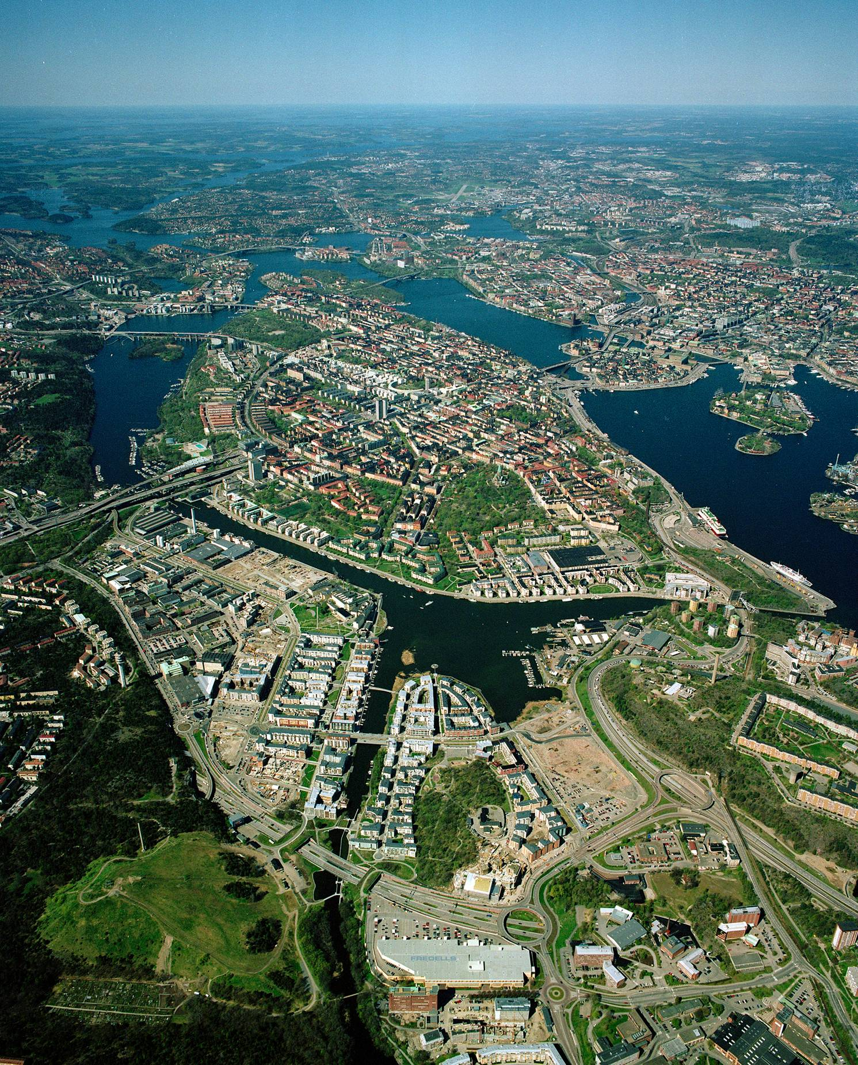

Slide 3
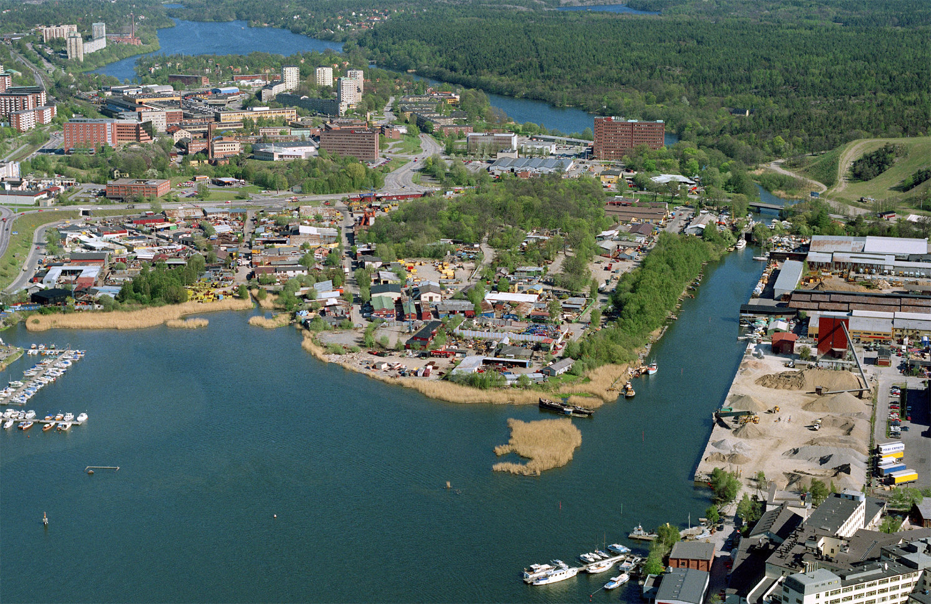

Slide 4
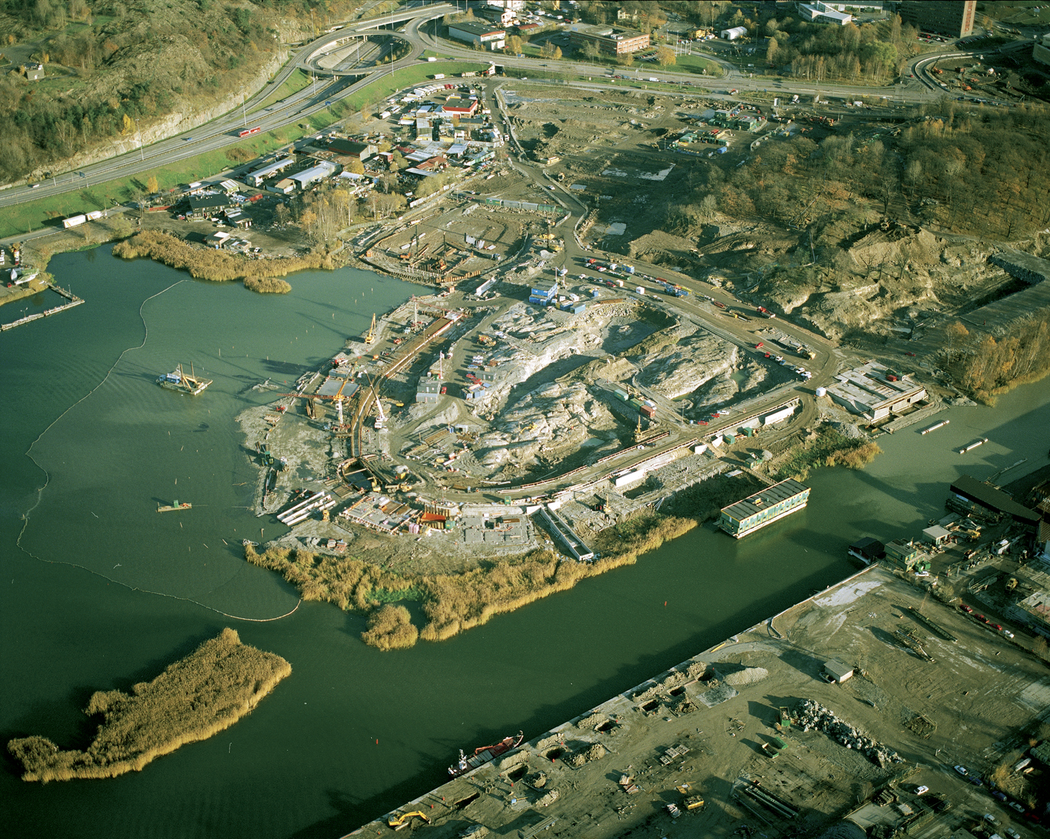
Brown field – soil cleaning
120 tons oil/grease 180 tons heavy metals

Slide 6
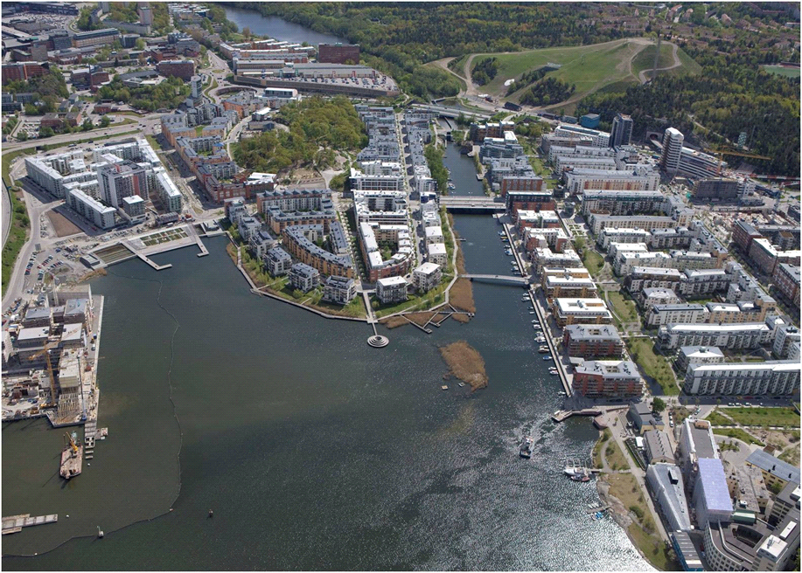

Slide 7
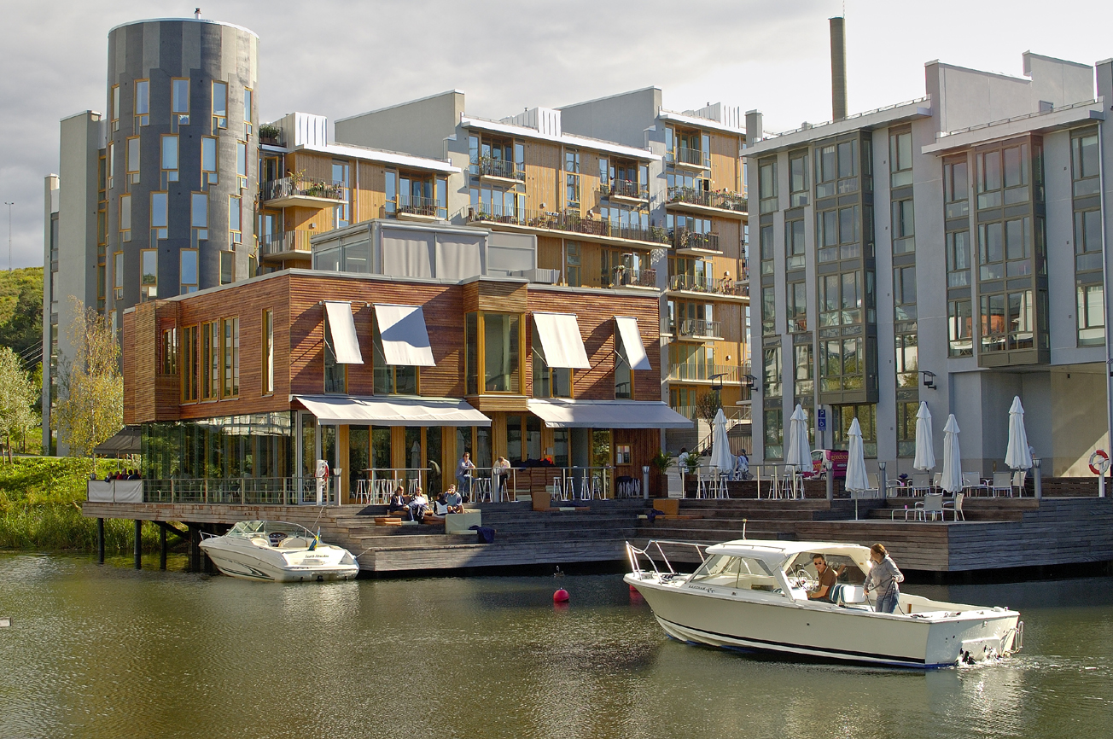

Slide 8
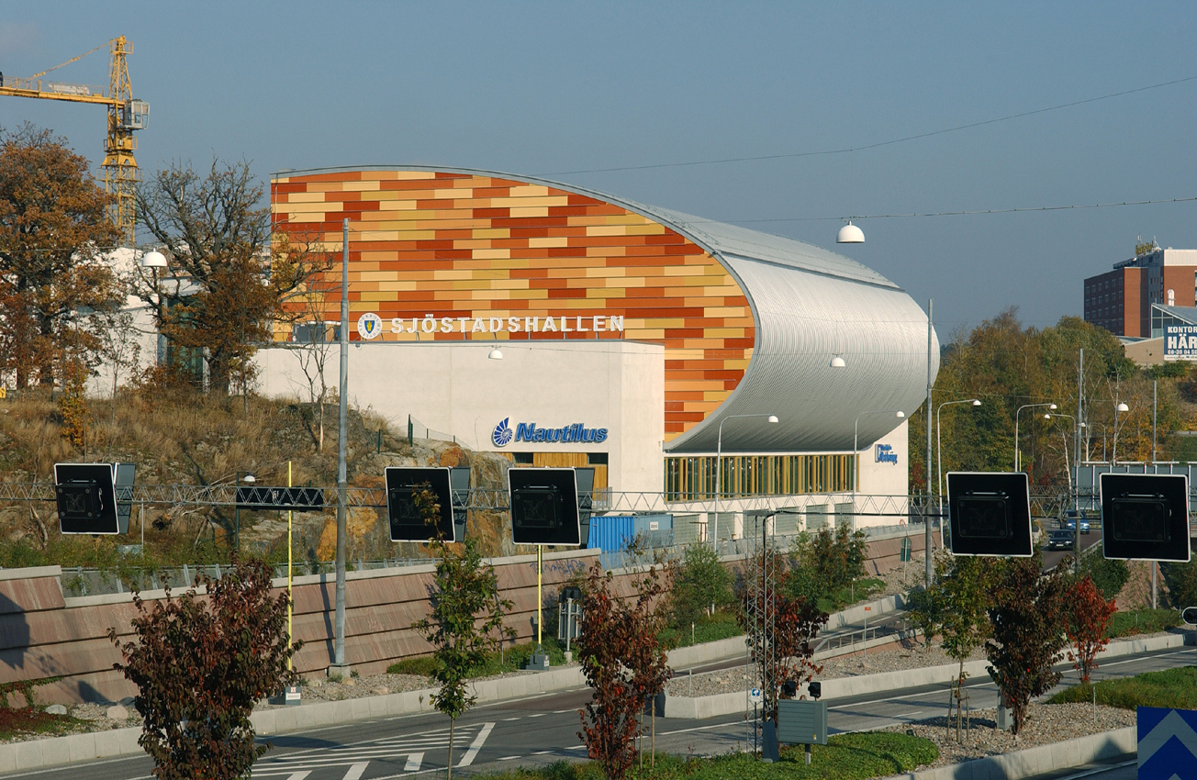

Slide 9
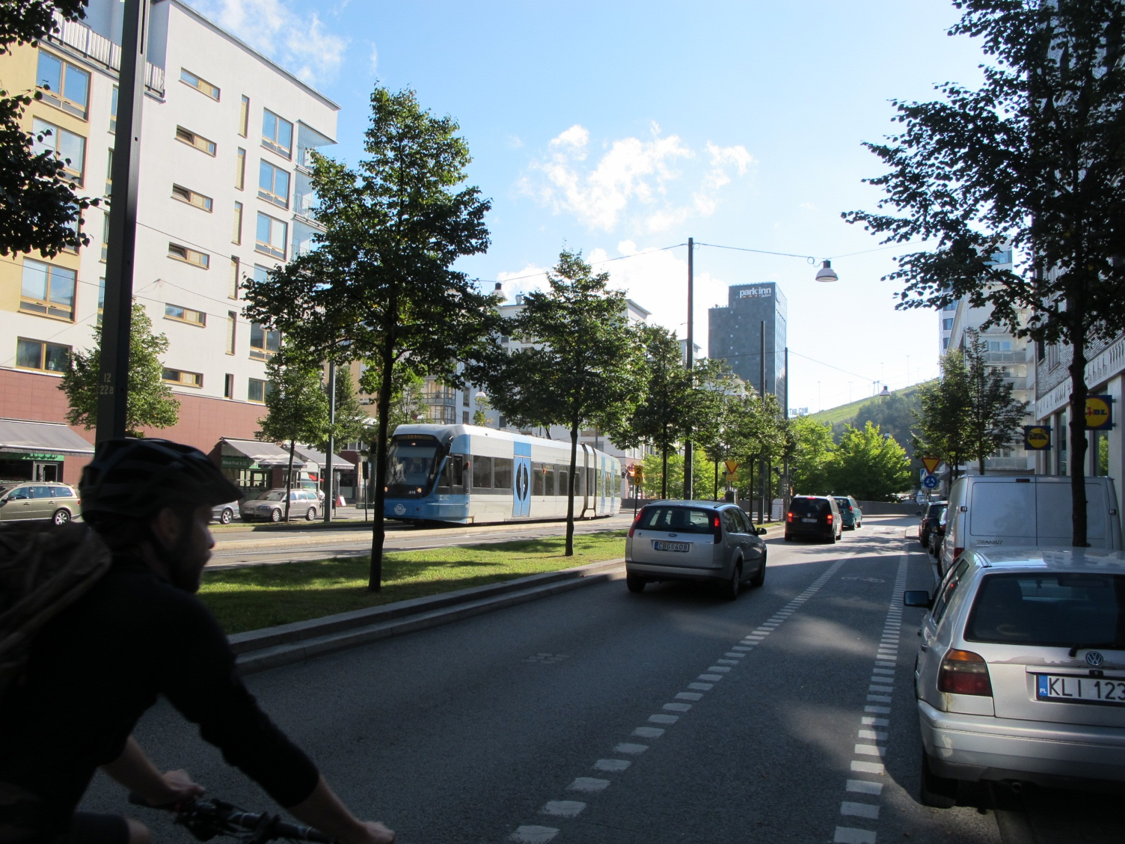

Slide 10
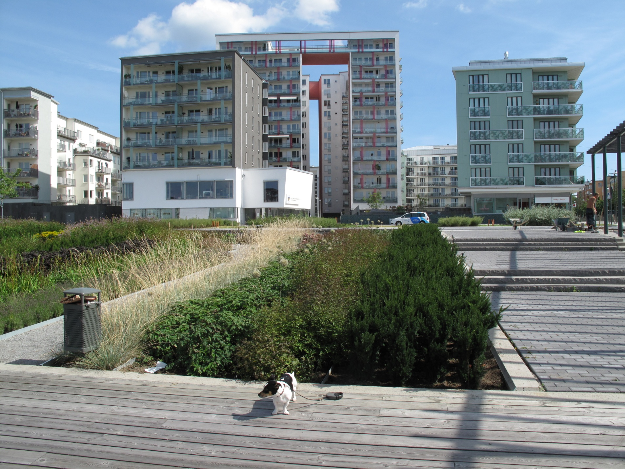

Slide 11
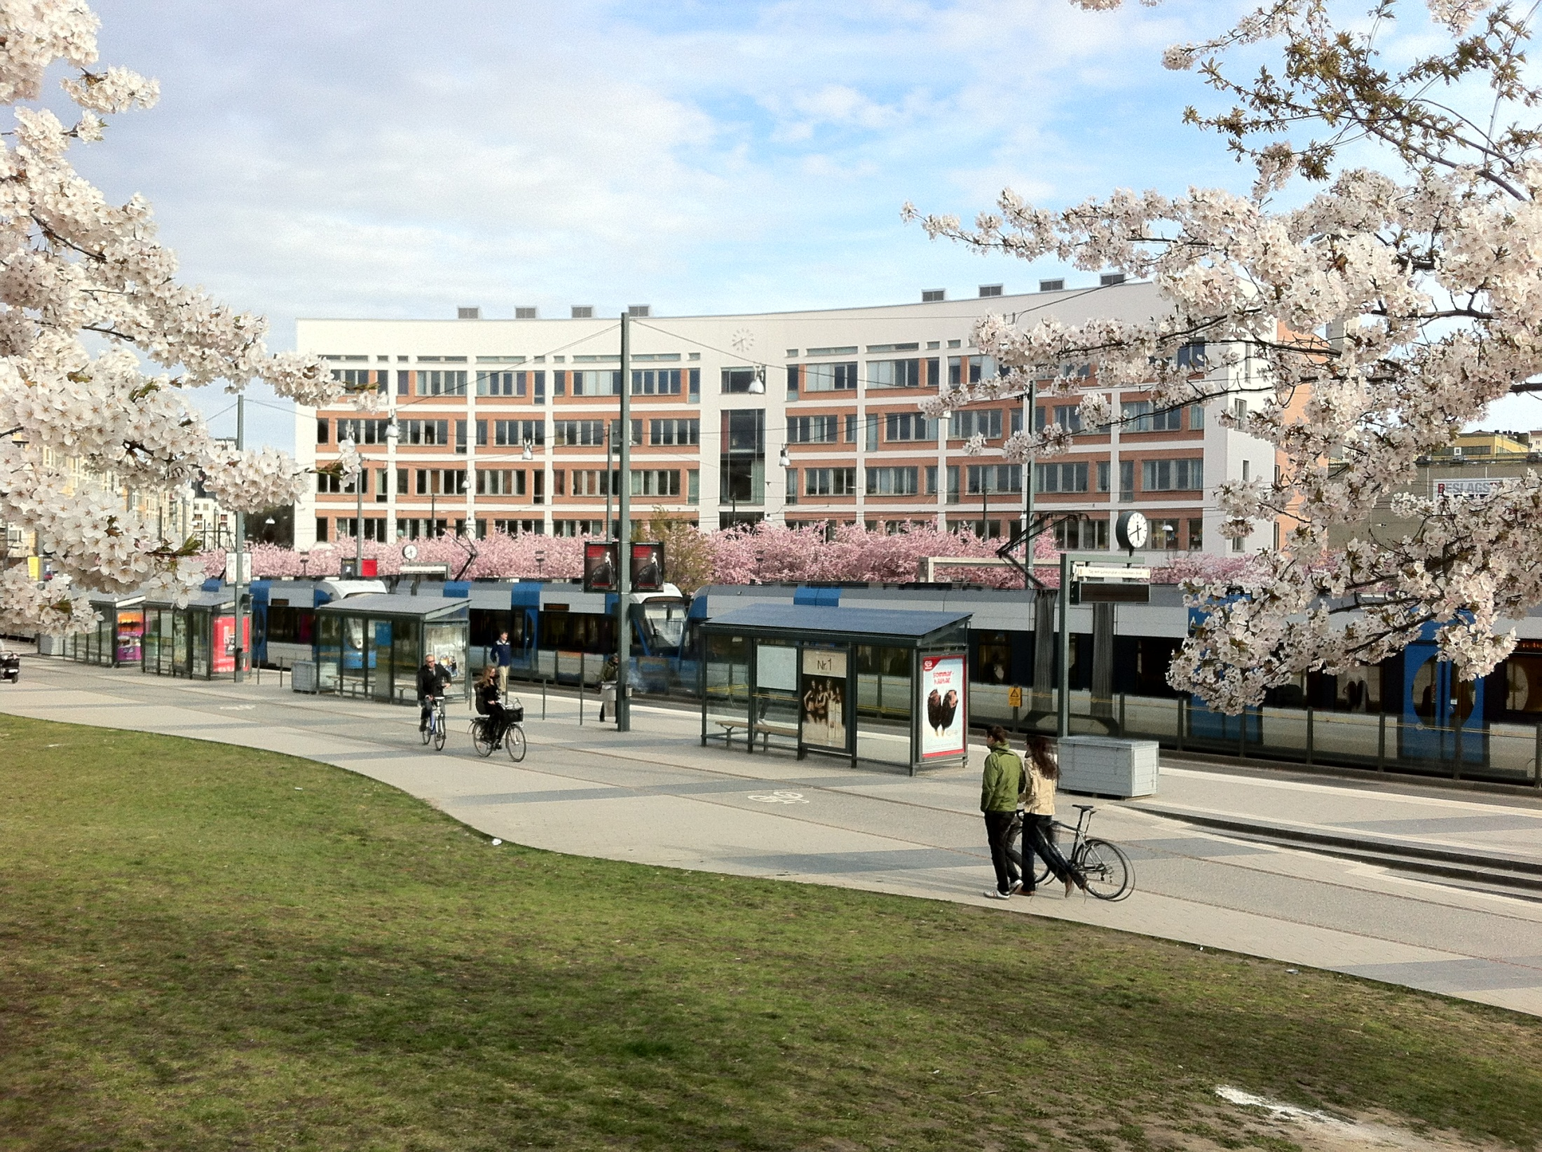

Slide 12
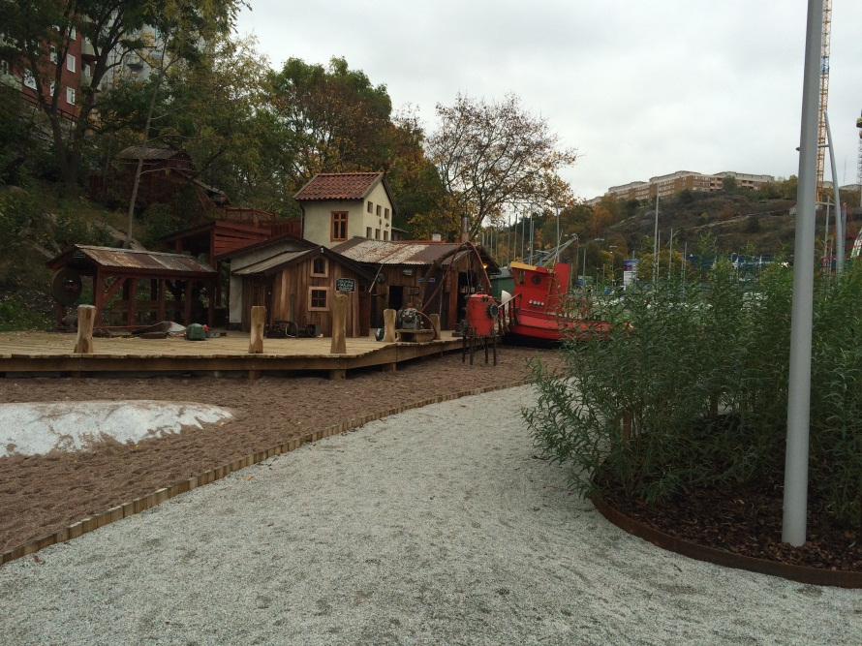
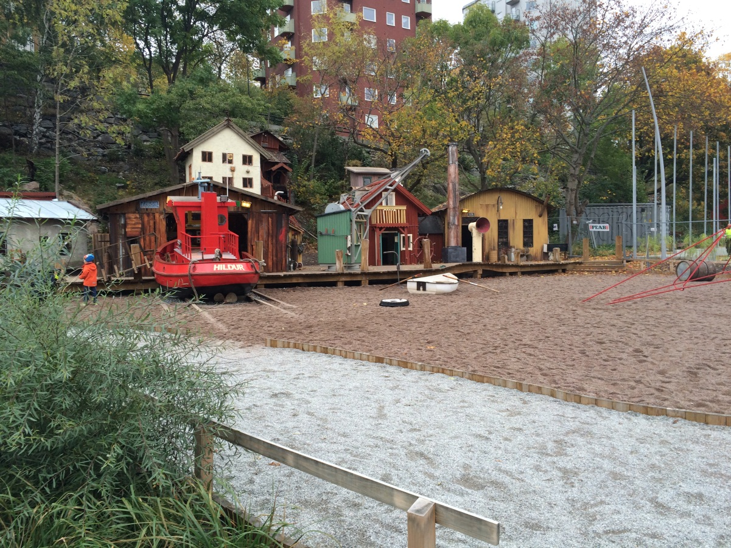

Slide 13
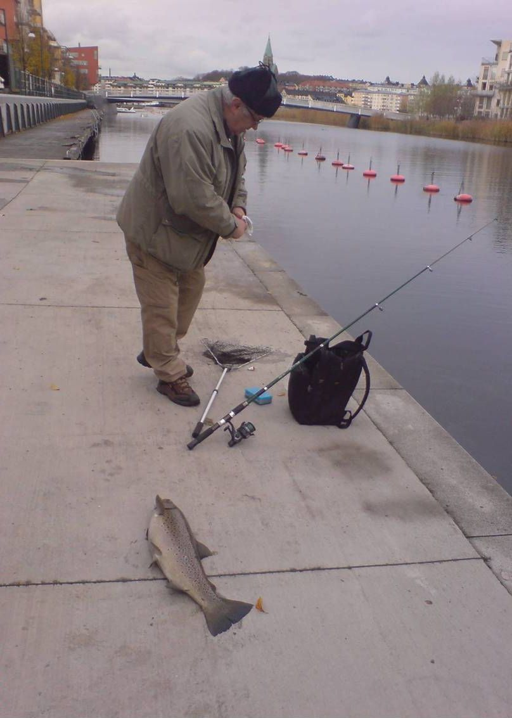
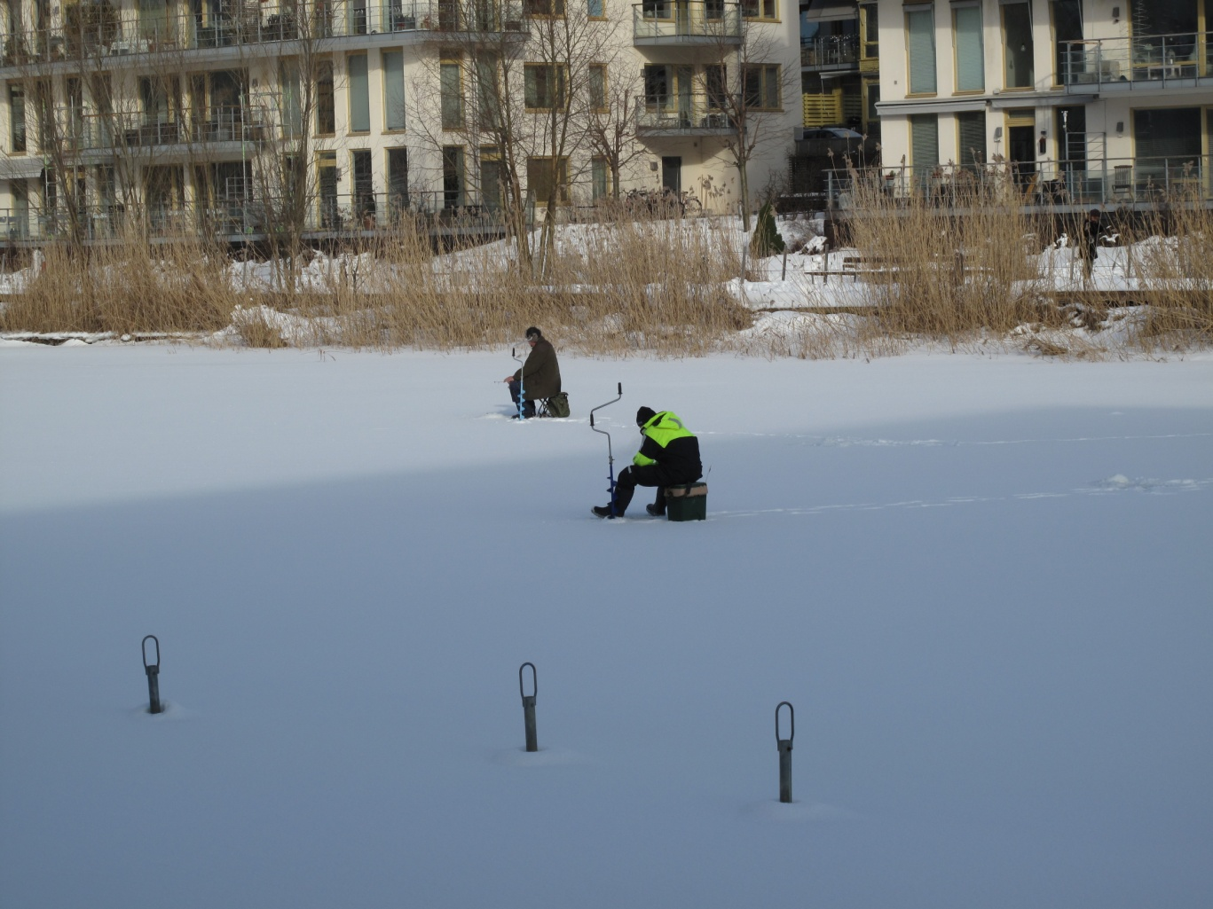

Slide 14
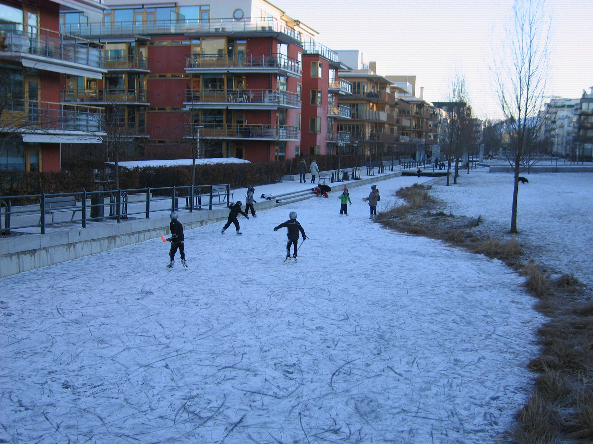

Slide 15
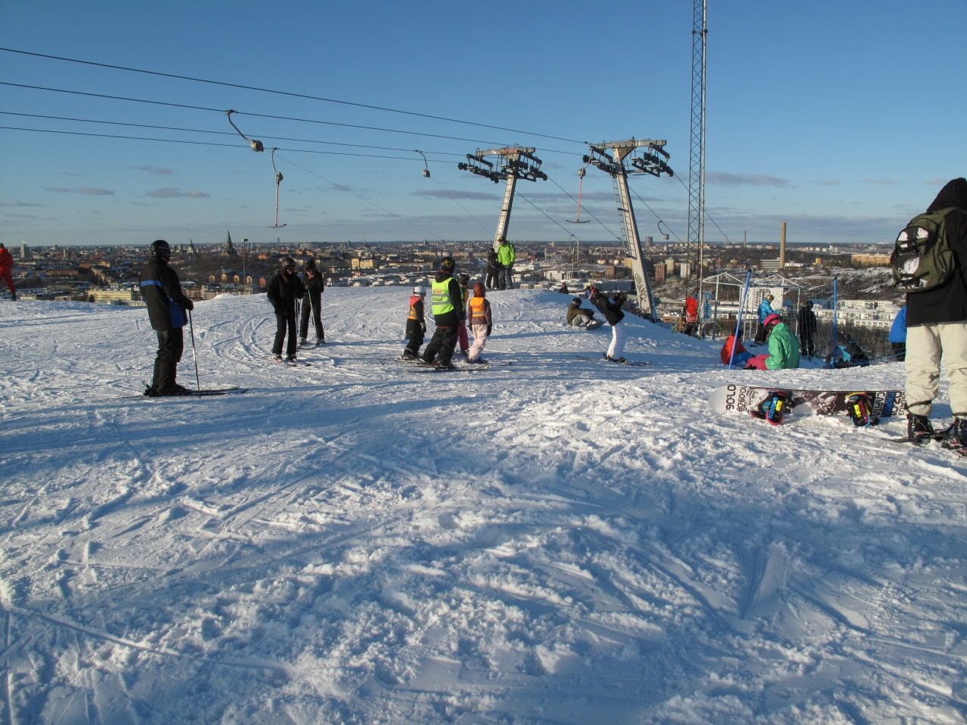
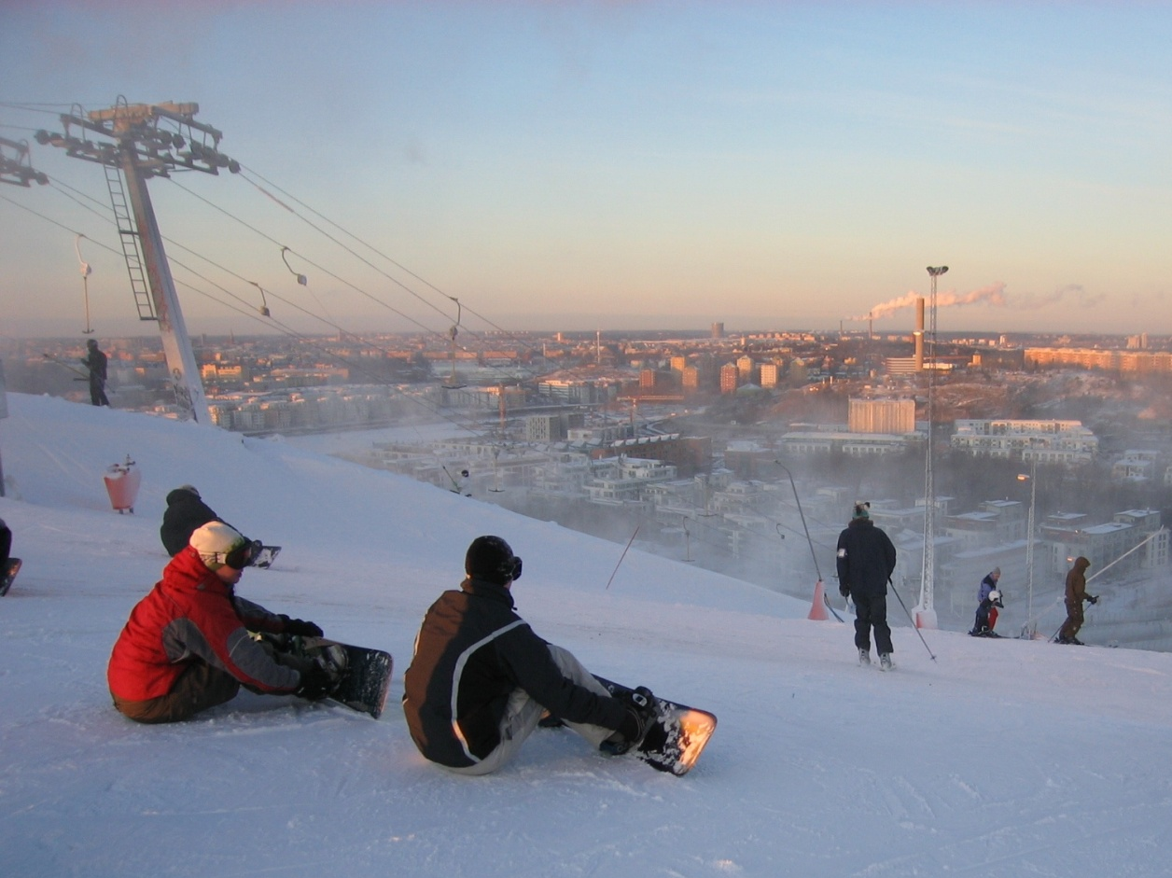

Slide 16


Slide 17
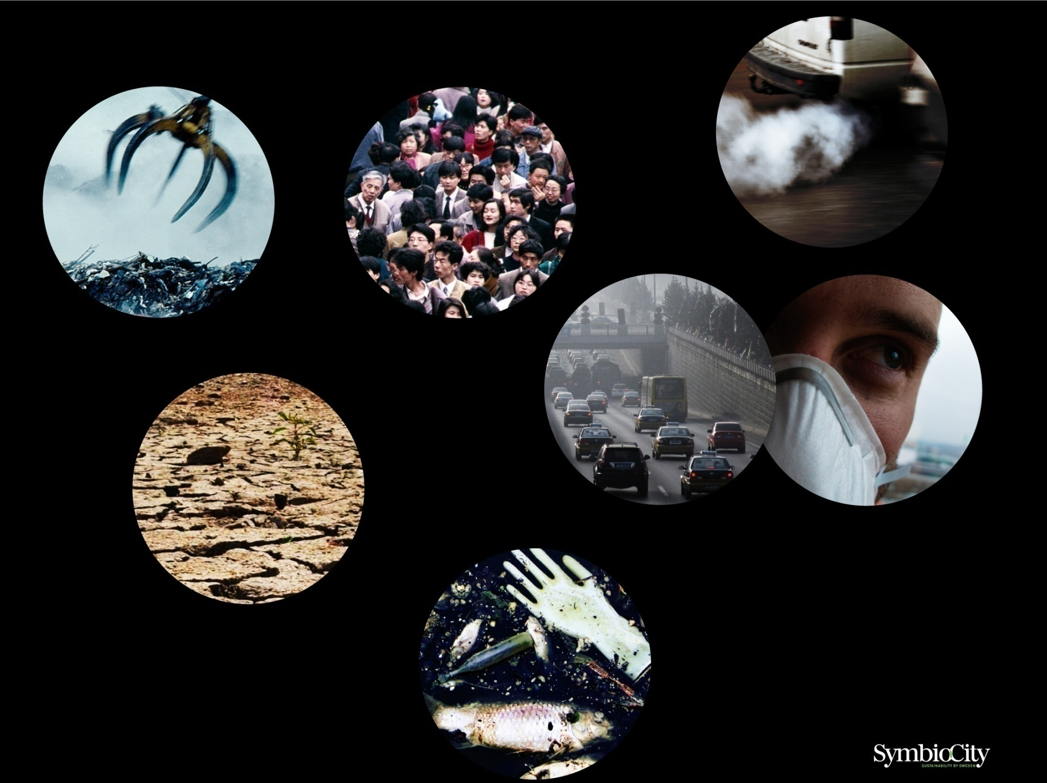
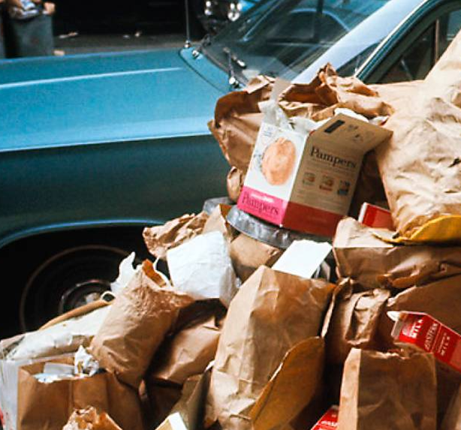
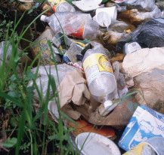

Slide 18
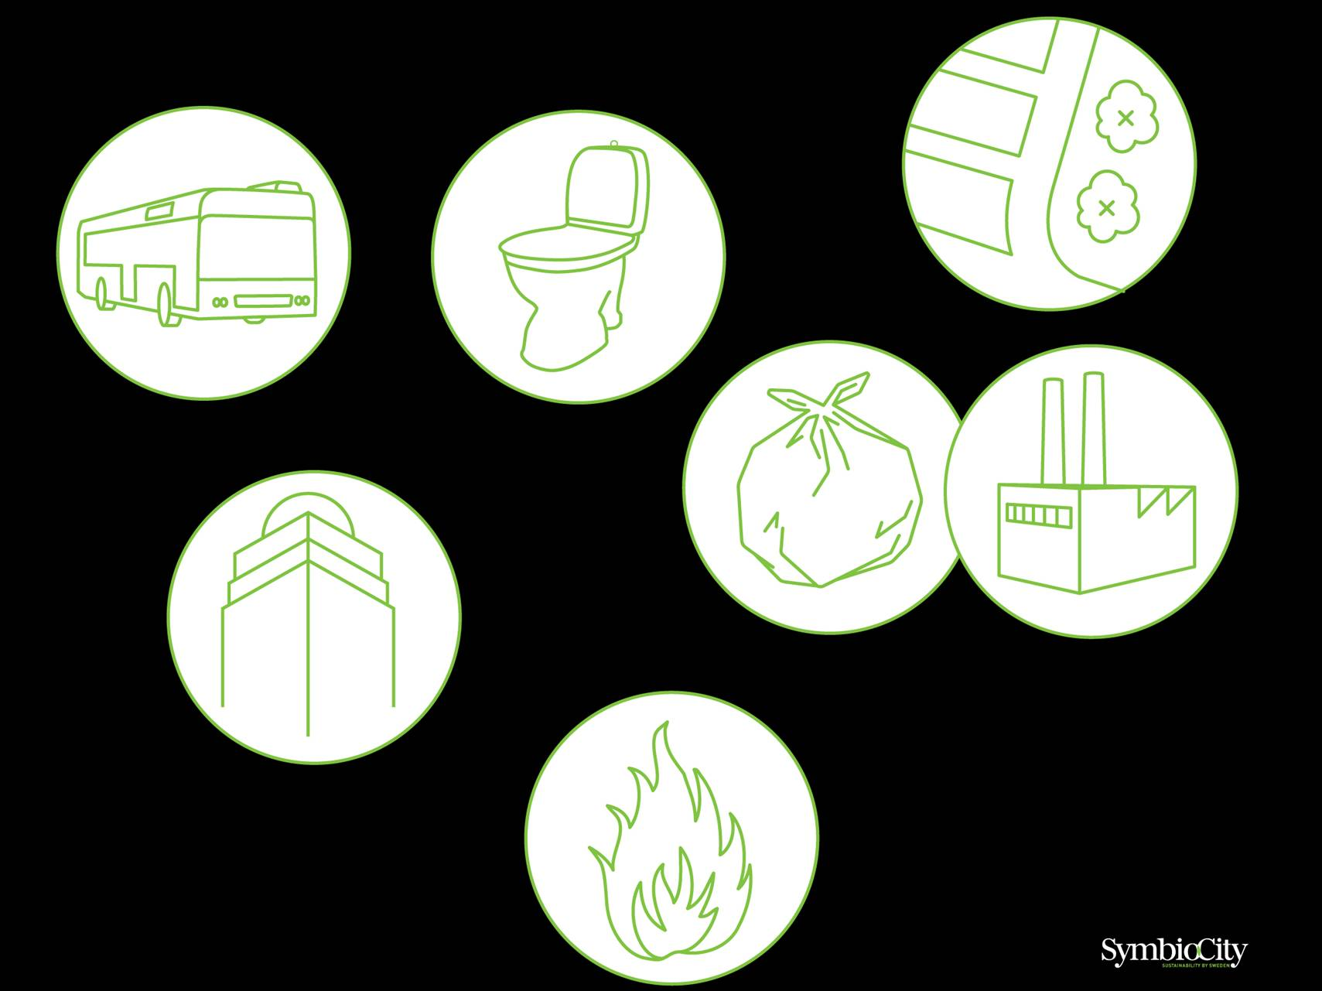
Notes:
18
URBAN SUBSYSTEMS, SCATTERED
Many of these solutions are individually effective. But, almost everywhere, we tend to look at problems in isolation from one another. We have to be better at seeing the whole picture and coordinate our solutions more.
Not only for the reason of a better environment. But also because there is a great deal of money in a better use of the synergies between the systems.

Slide 19
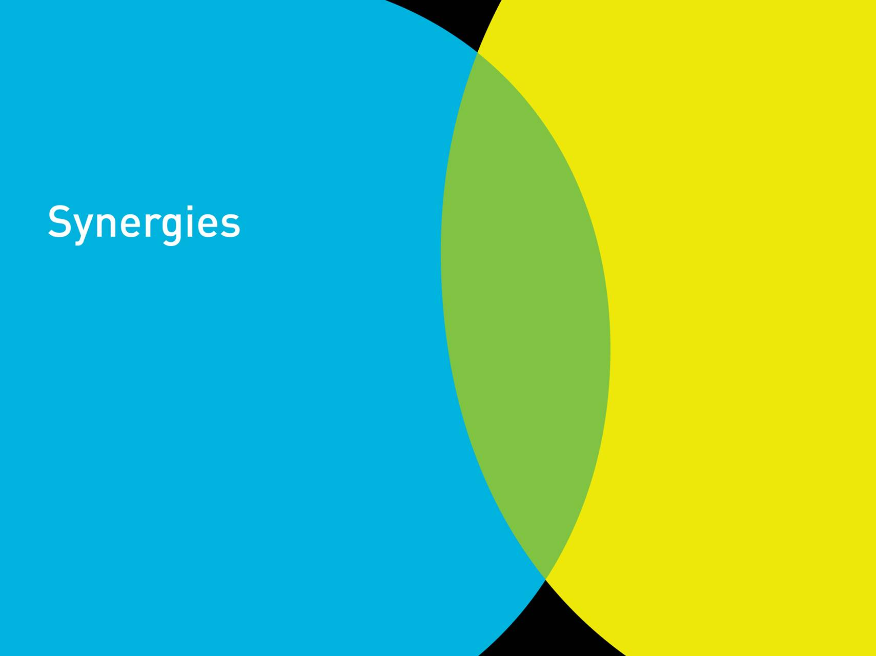

Slide 20
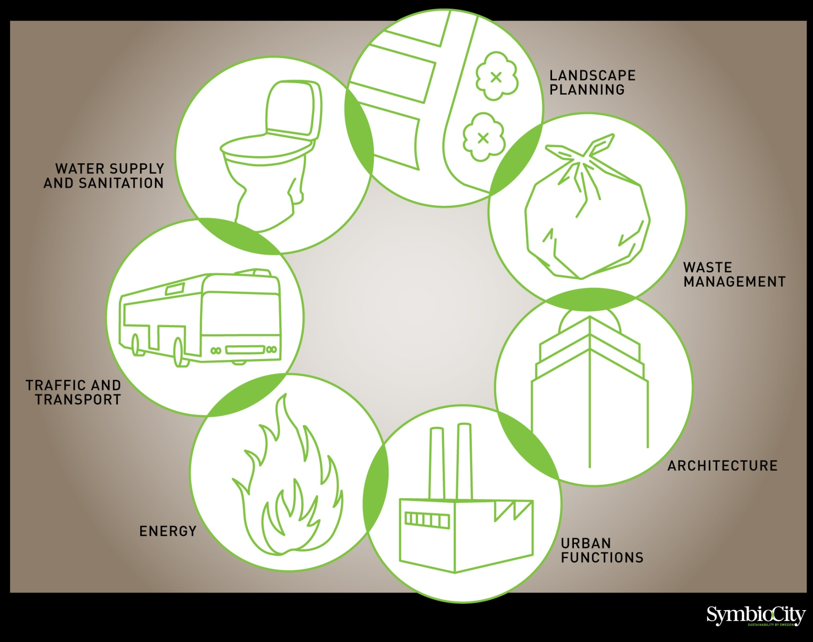

Slide 21
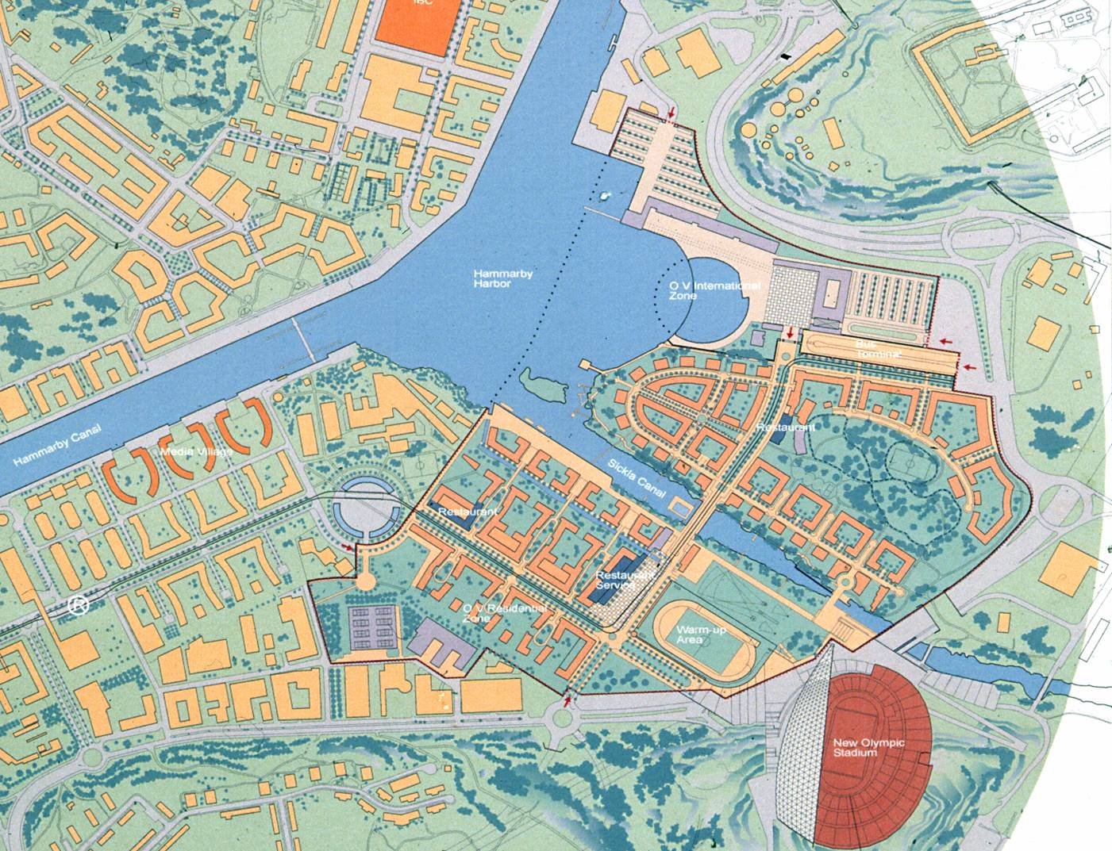
The Olympic project 2004

Slide 22
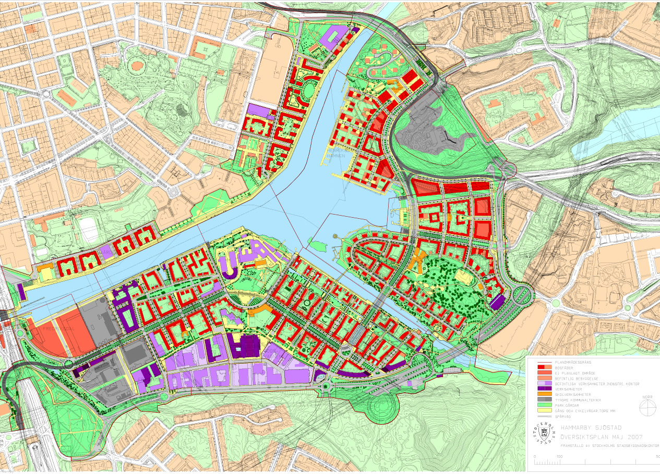
Environmental programme
Lower the total environmental impact by half

Slide 23
Environmental programme
land use
soil pollution
energy
water and sewage
garbage
building material
transportation
noise
green areas

Slide 24
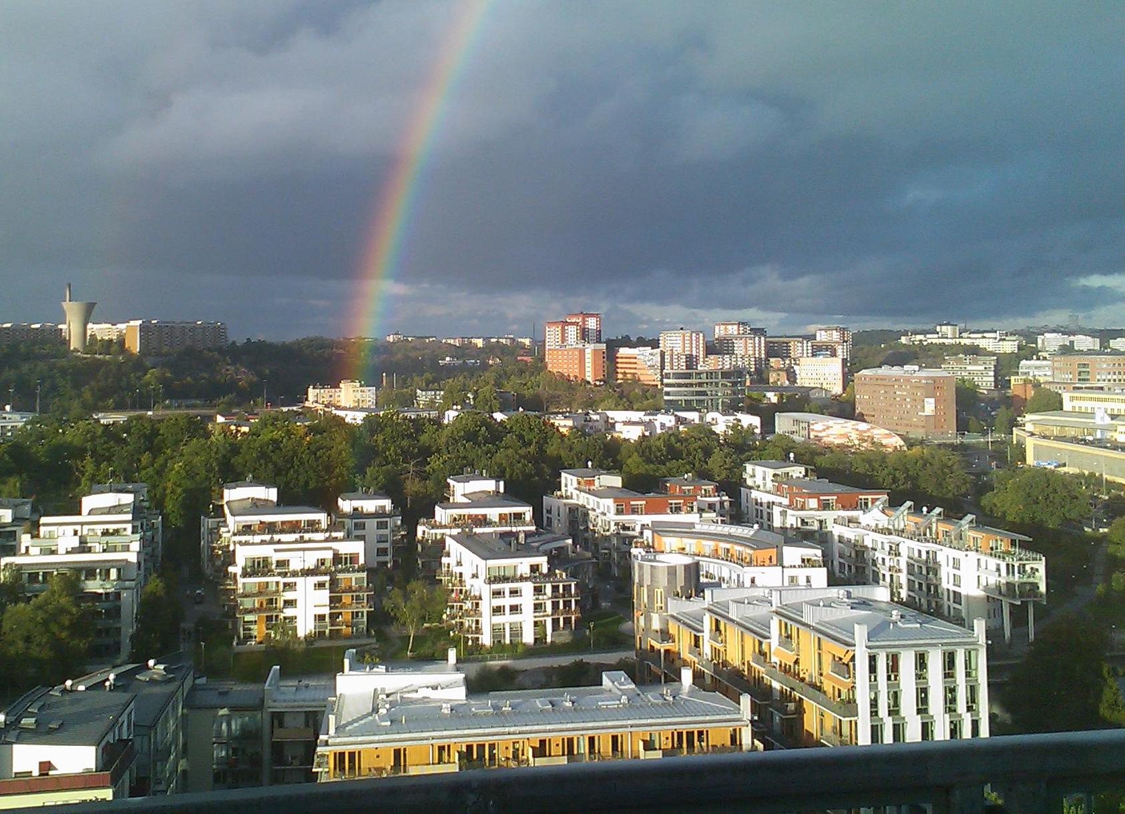
Hammarby Sjöstad
12 000 flats
28 000 people –
live
10 000 people – work
------------
1997 started
and est finish
2020

Slide 25
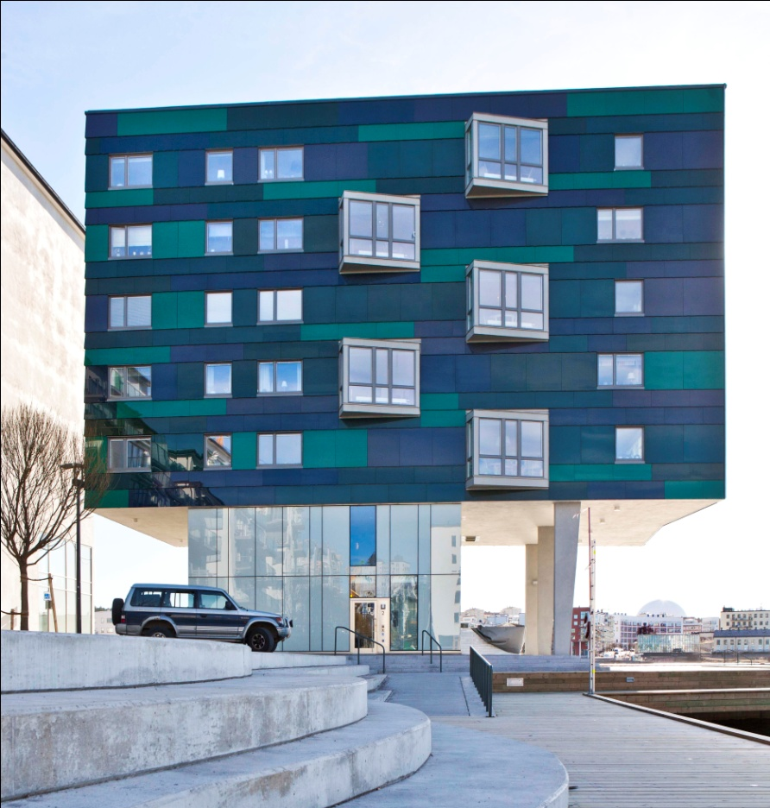

Size: 500 acres (420 acres land)
Costs: US$ 4.8 billion
Investment from the City
net: US$ 0.3 billion
The City of Stockholm
had owned almost all land
The land is sold
or leased to the developers
Cooperation between the City
Planning Dept and the developers
architects.

Slide 26
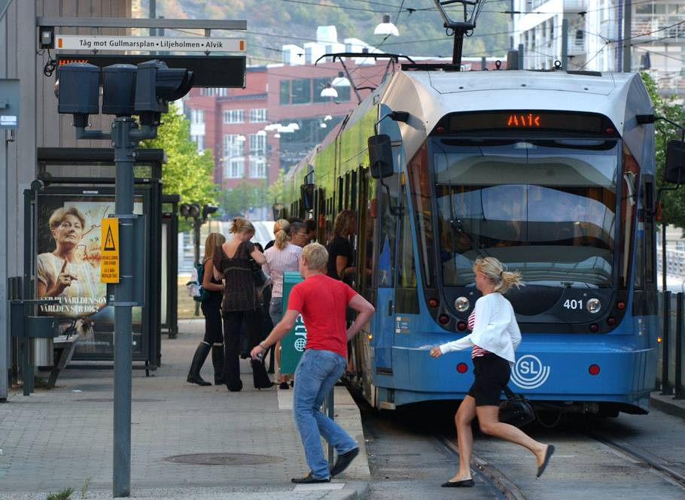
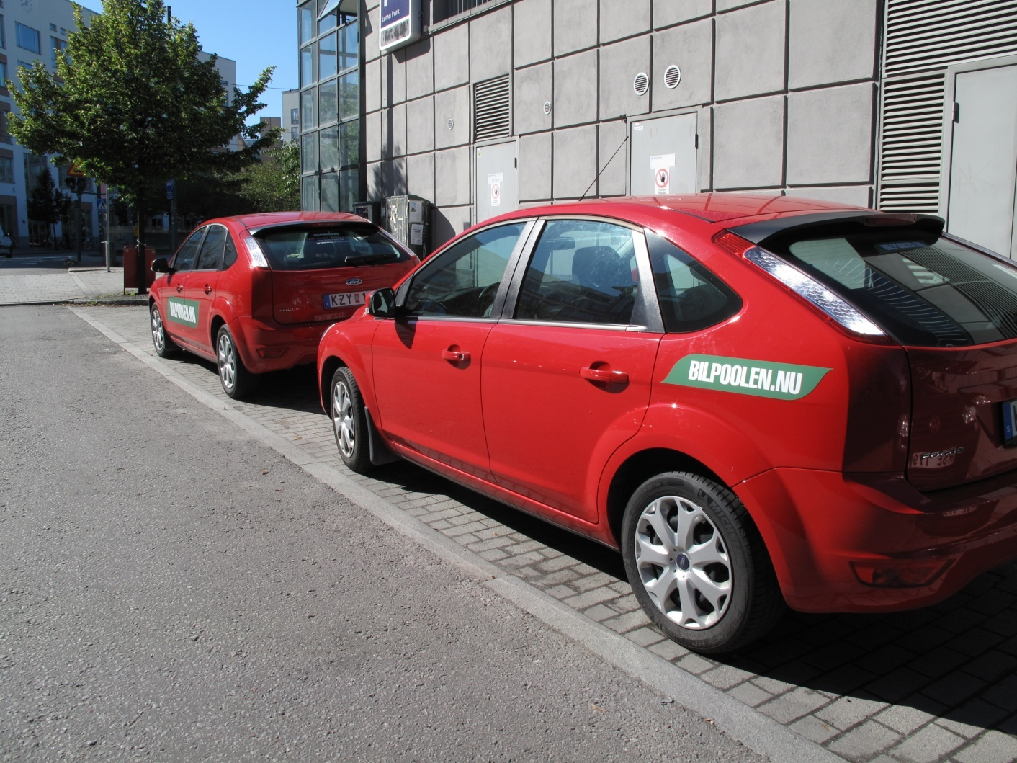
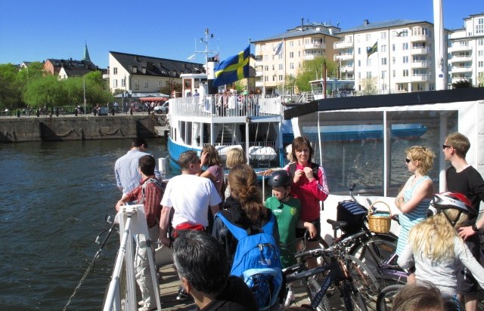
Local traffic
Public Transport/
Car Pool/Ferry
Decrese car use 40%

Slide 27

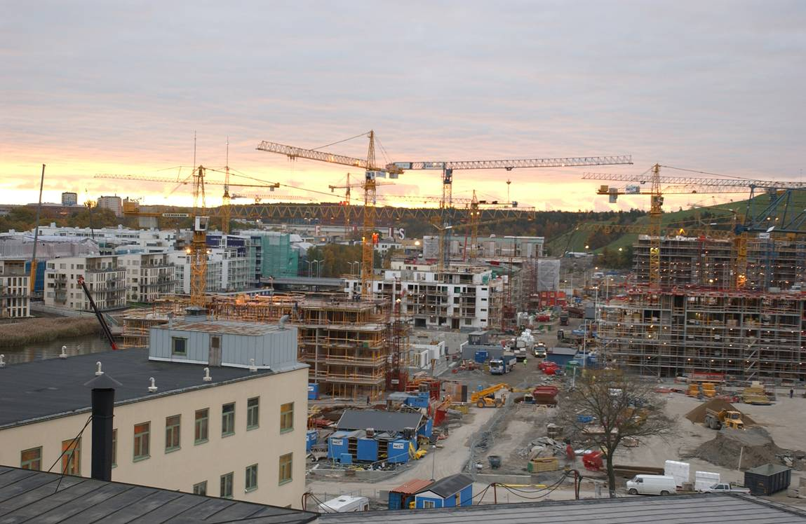







Developers – builders

Slide 28
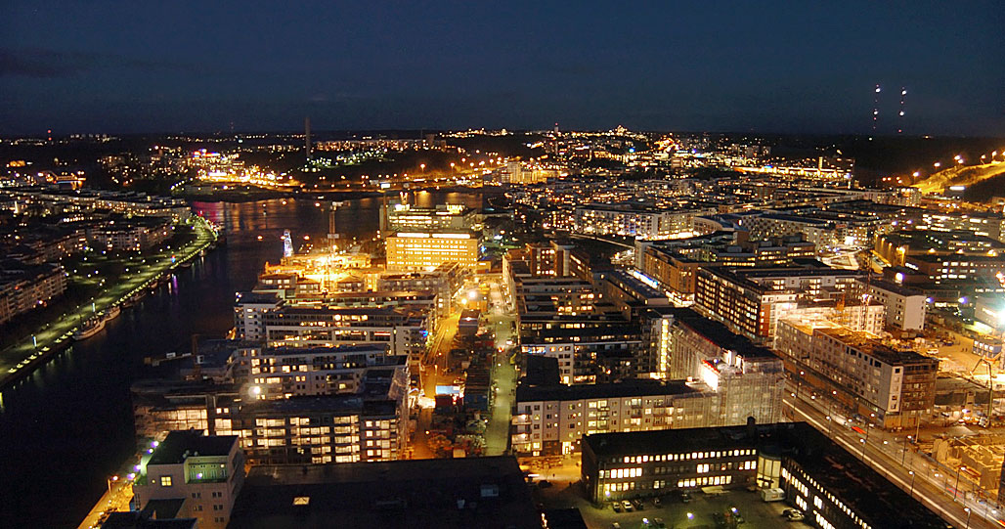
Developer
Extra cost to the total budget
2 – 4 %
(Stefan Sjödin, Fortum)

Slide 29
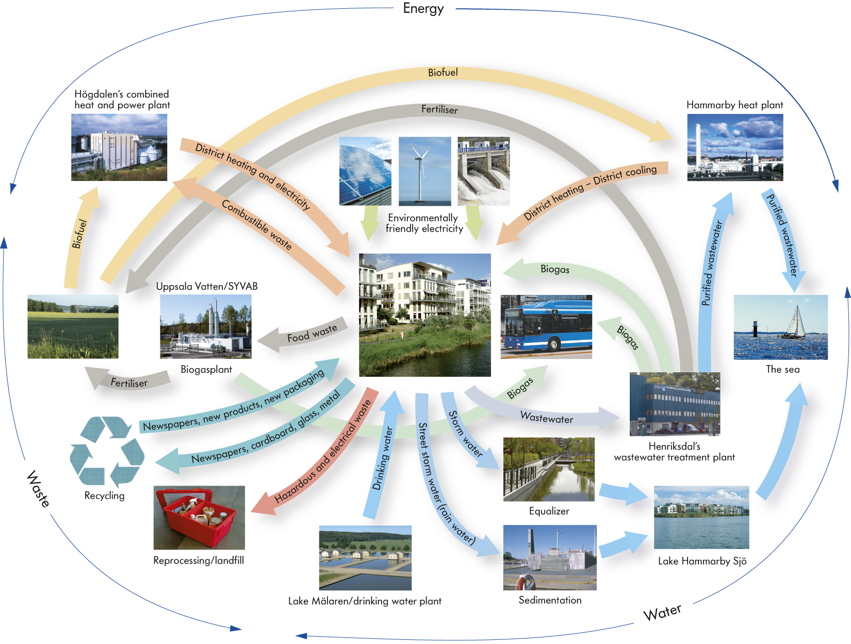
The Hammarby model

Slide 30
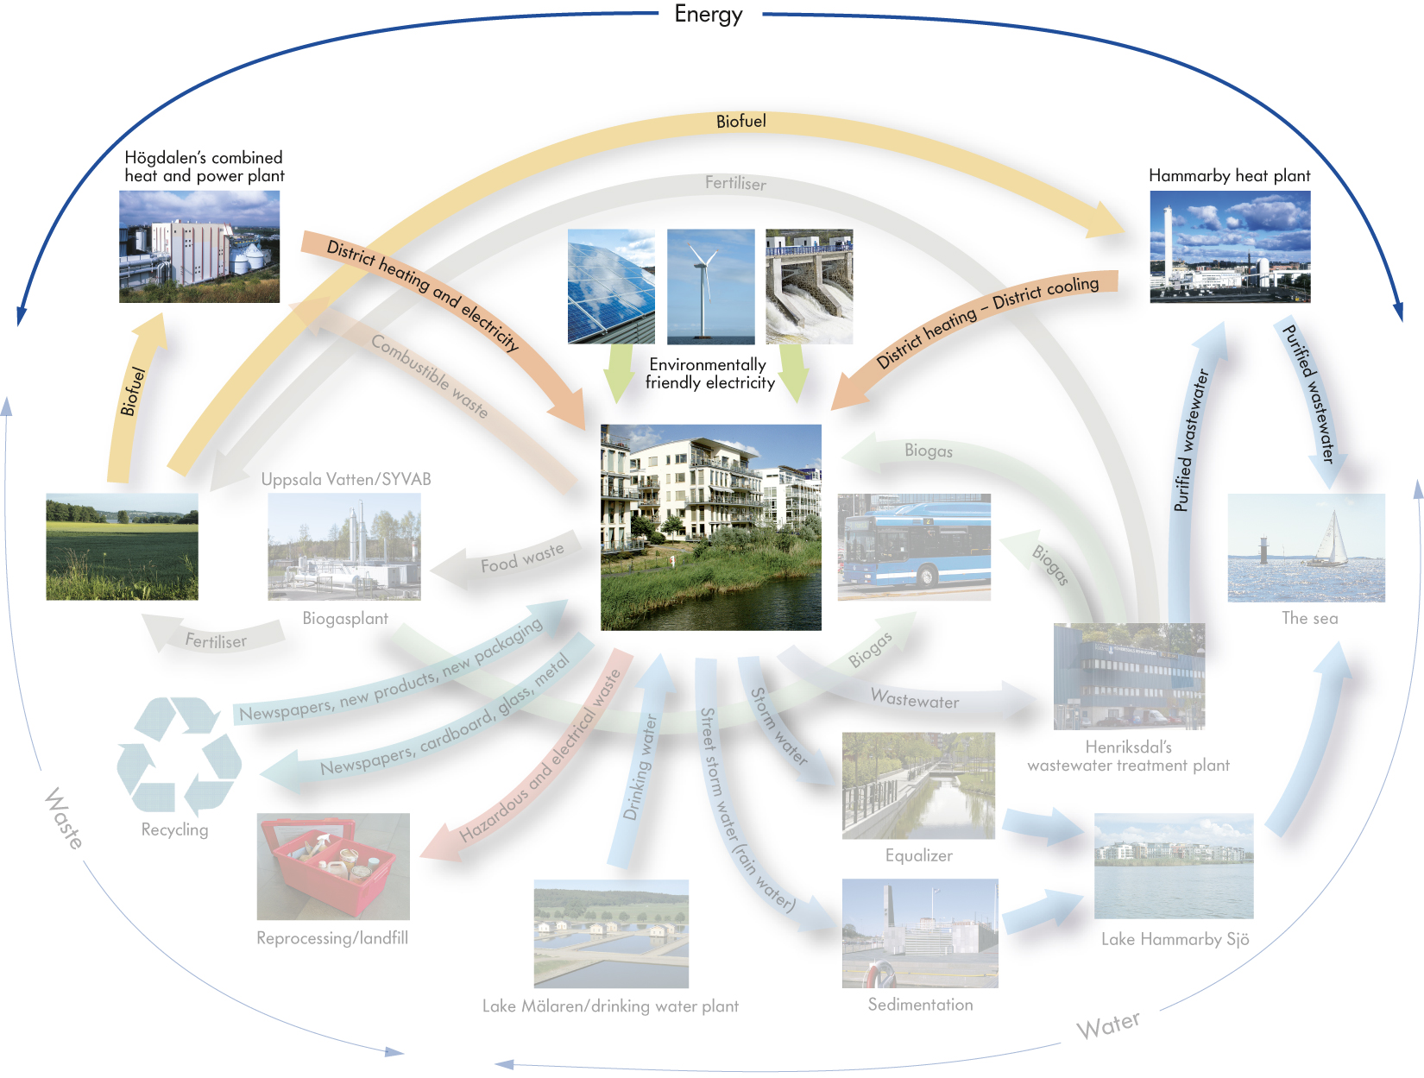
Energy

Slide 31

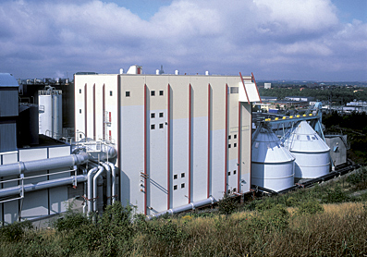
District heating
Combustible
waste is
incinerated
District heating,
hot tap water
and electricity

Slide 32
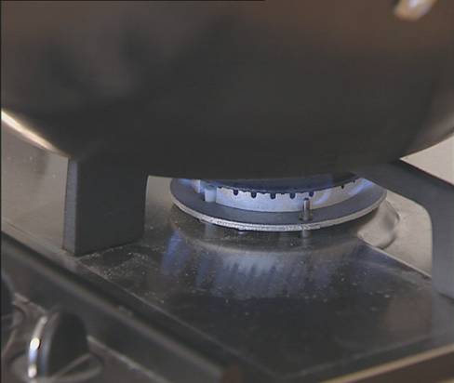
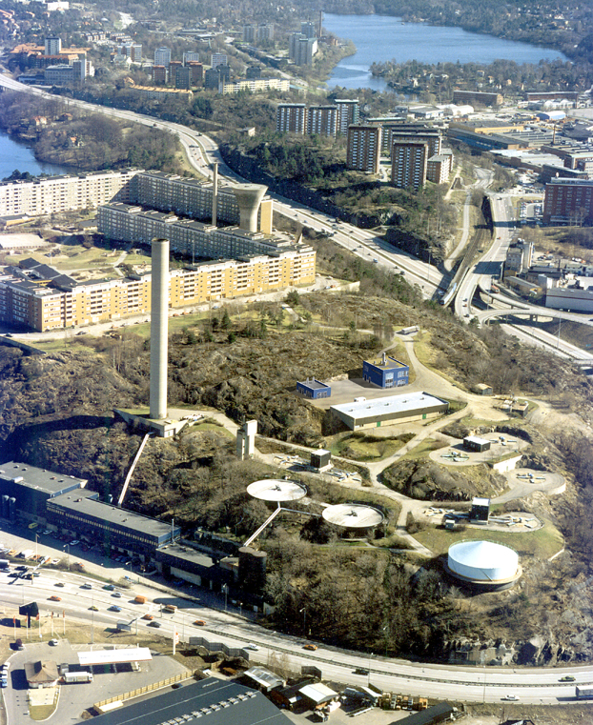
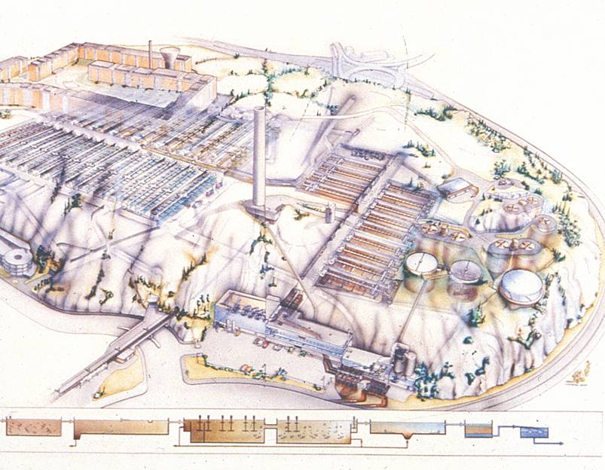
Biogas

Slide 33
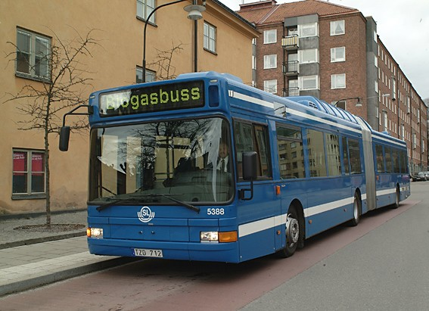
Biogas busses/cars

Slide 34
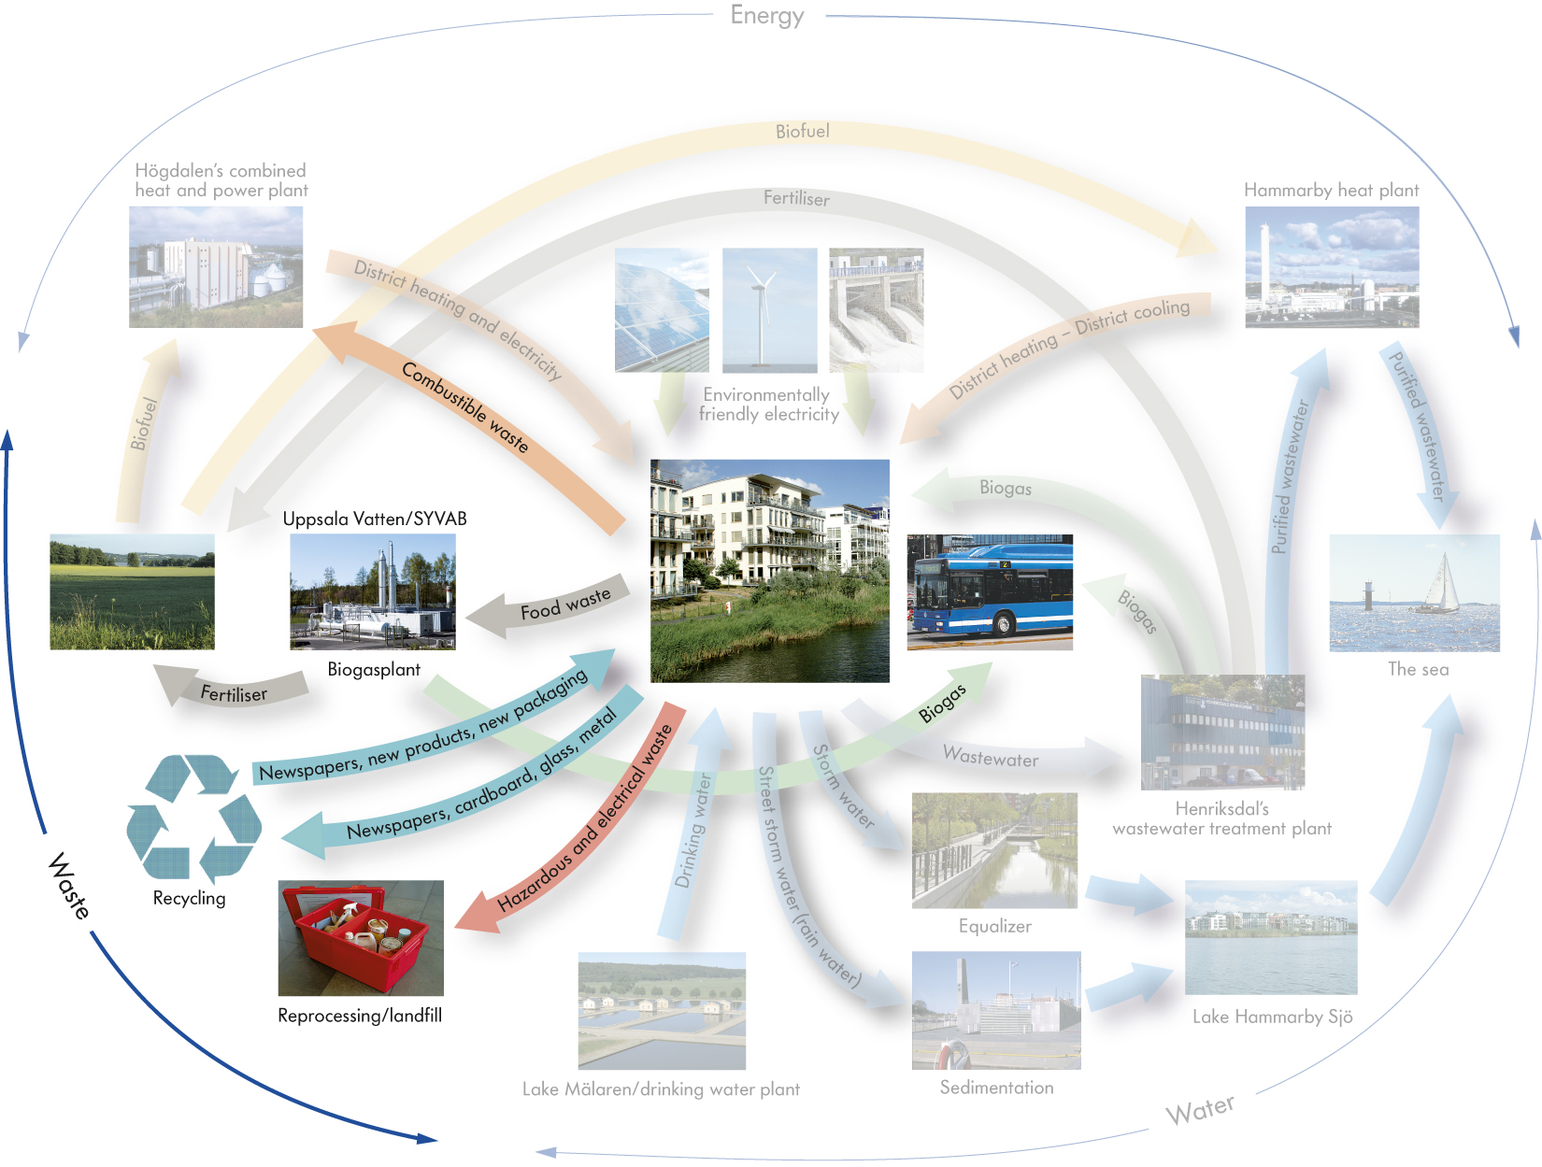
Waste

Slide 35
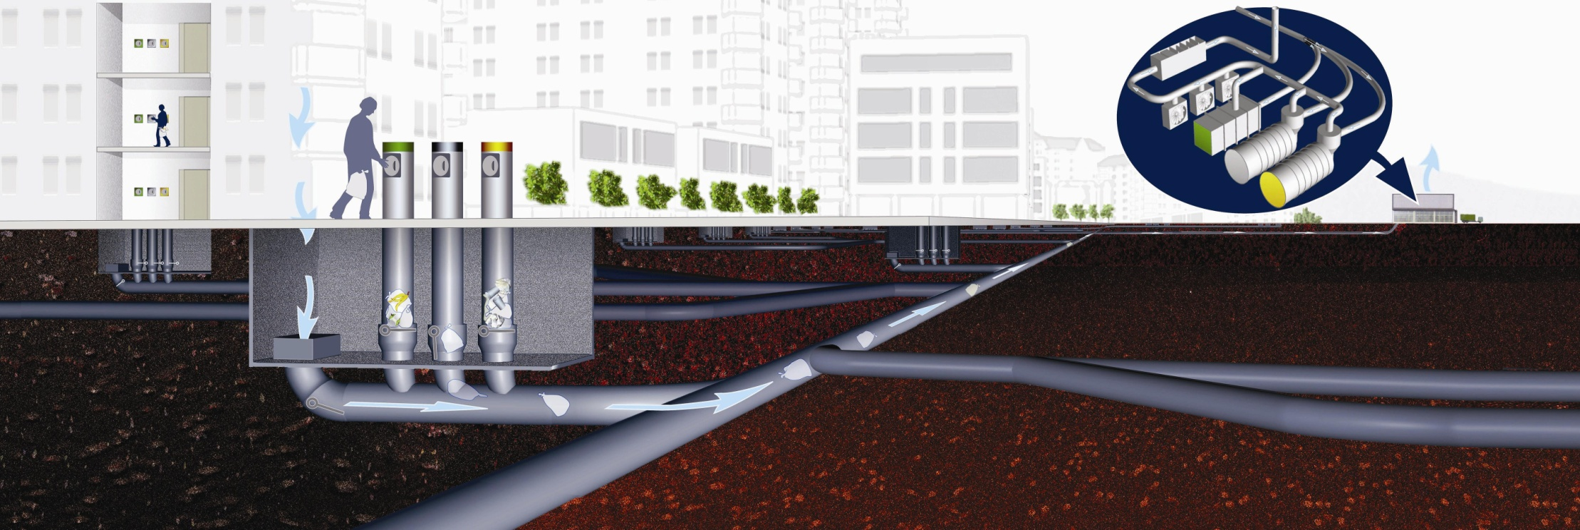

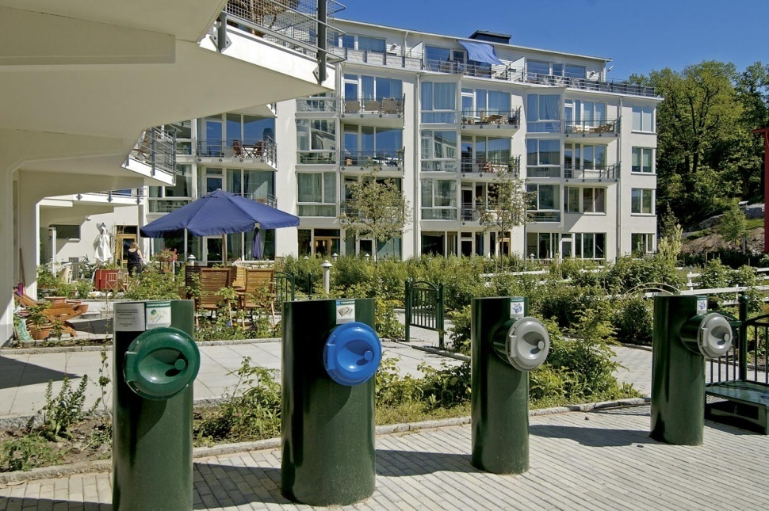
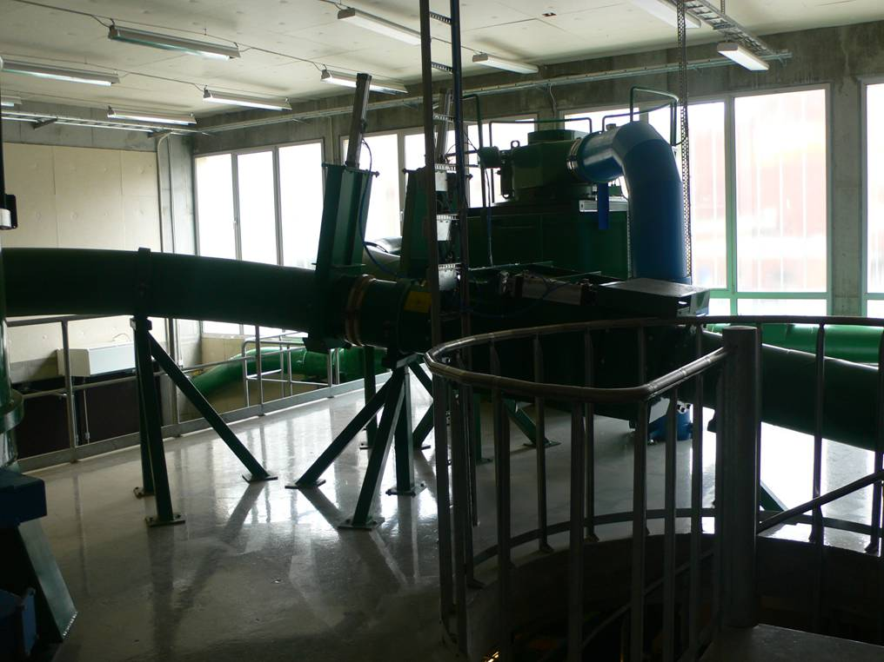
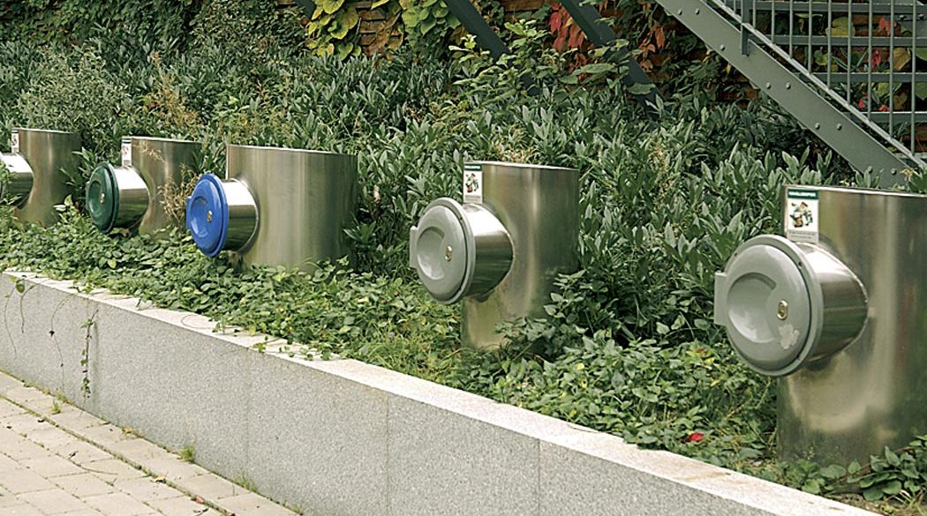
Stationary vacuum system
for solid waste

Slide 36
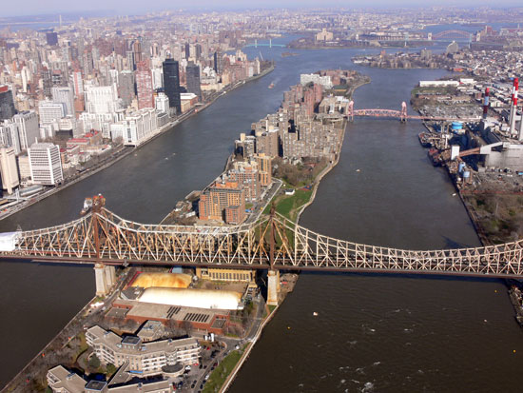
Roosevelt Island

Slide 37
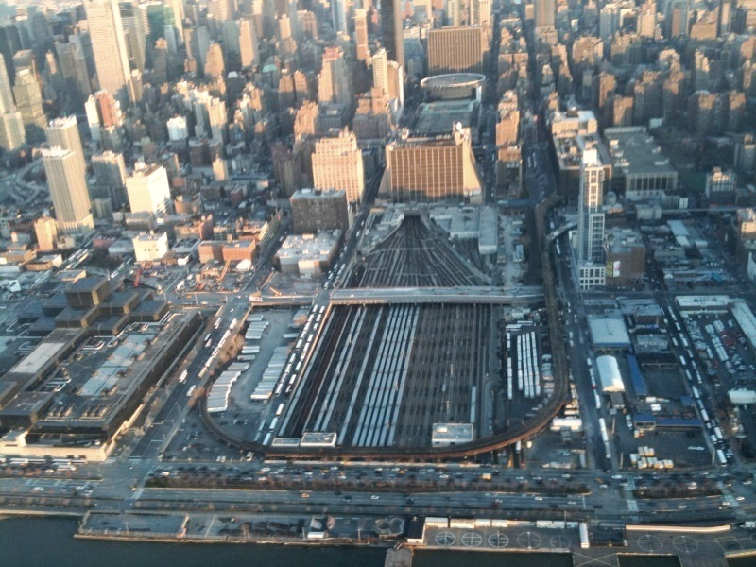
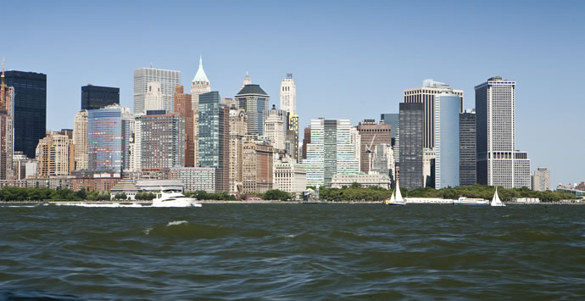
Hudson Yards, New York

Slide 38
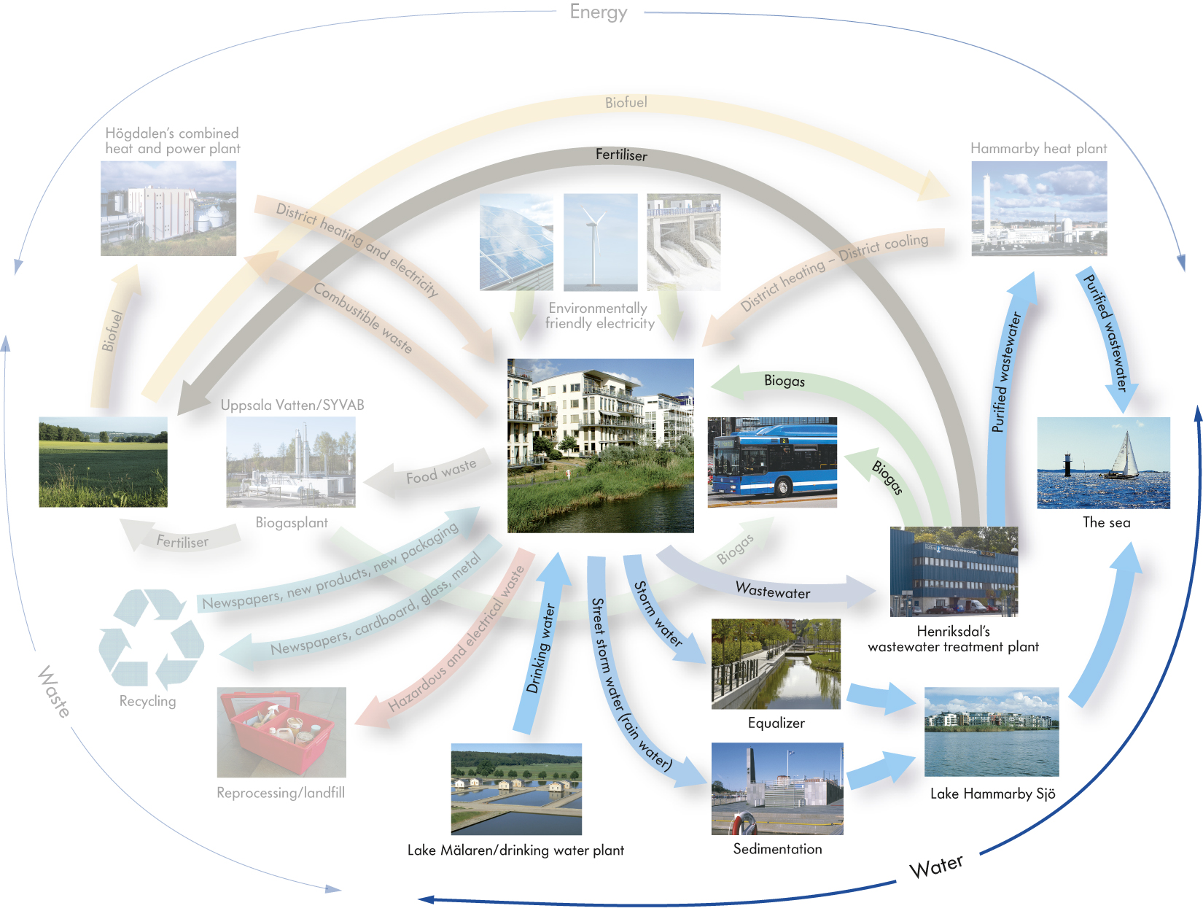
Water

Slide 39
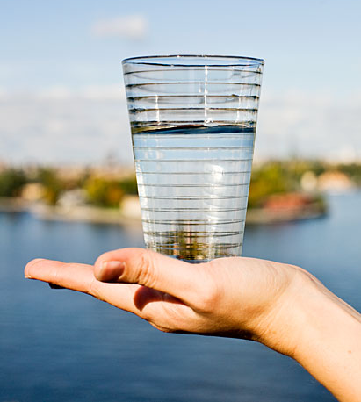
Water consumption
200 l/p/day
100 l/p/day
Today
150 l/p/d

Slide 40
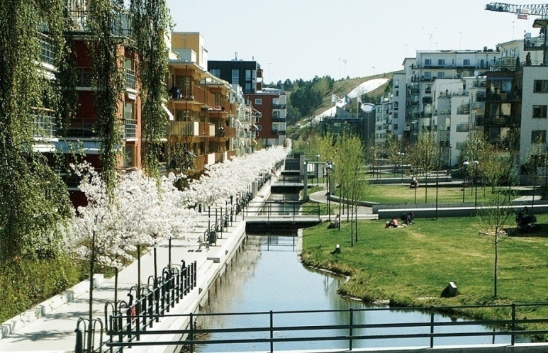



Storm water solutions

Slide 41

The park system

Slide 42





Slide 43

75 % of all targets built in the buildings and the infrastructure

Slide 44


Stockholms Stad

Slide 45

Achievement
Aim: Lower by half
Result: 30 – 40%

Slide 46

Lessons learned from
Hammarby Sjöstad
Set up a vision for the project
Cooperate with all participating parties both governmental and private
When you set up the targets be specific so they can all be measurable
Holistic perspective

Slide 47


Norra Djurgårdsstaden –
The Stockholm Royal Sea Port

Slide 48

The key to Hammarby Sjöstad’s
success –

Slide 49

- Integrated planning

Slide 50


Slide 51

The earth provides enough to satisfy every man’s need.
But not every man’s greed
(Mahatma Gandhi).
www.stockholm.se/hammarbysjostad
www.stockholmvatten.se/glashusett

Slide 52

Tack så
mycket!

